Slide 1
Estimating Substitution Patterns using text: Evidence from the movie industry
Gideon Moore
May 20, 2024
Industrial Organization III

Slide 2


Which Movie is This?
From the late 2010s
November release
Sequel to movie from earlier in the decade
Stars Kristen Bell
Joint screenwriter/director
Winter theme
Emphasizes the value of family
Runtime of just over 100 minutes
Grossed more than 5x budget

Slide 3
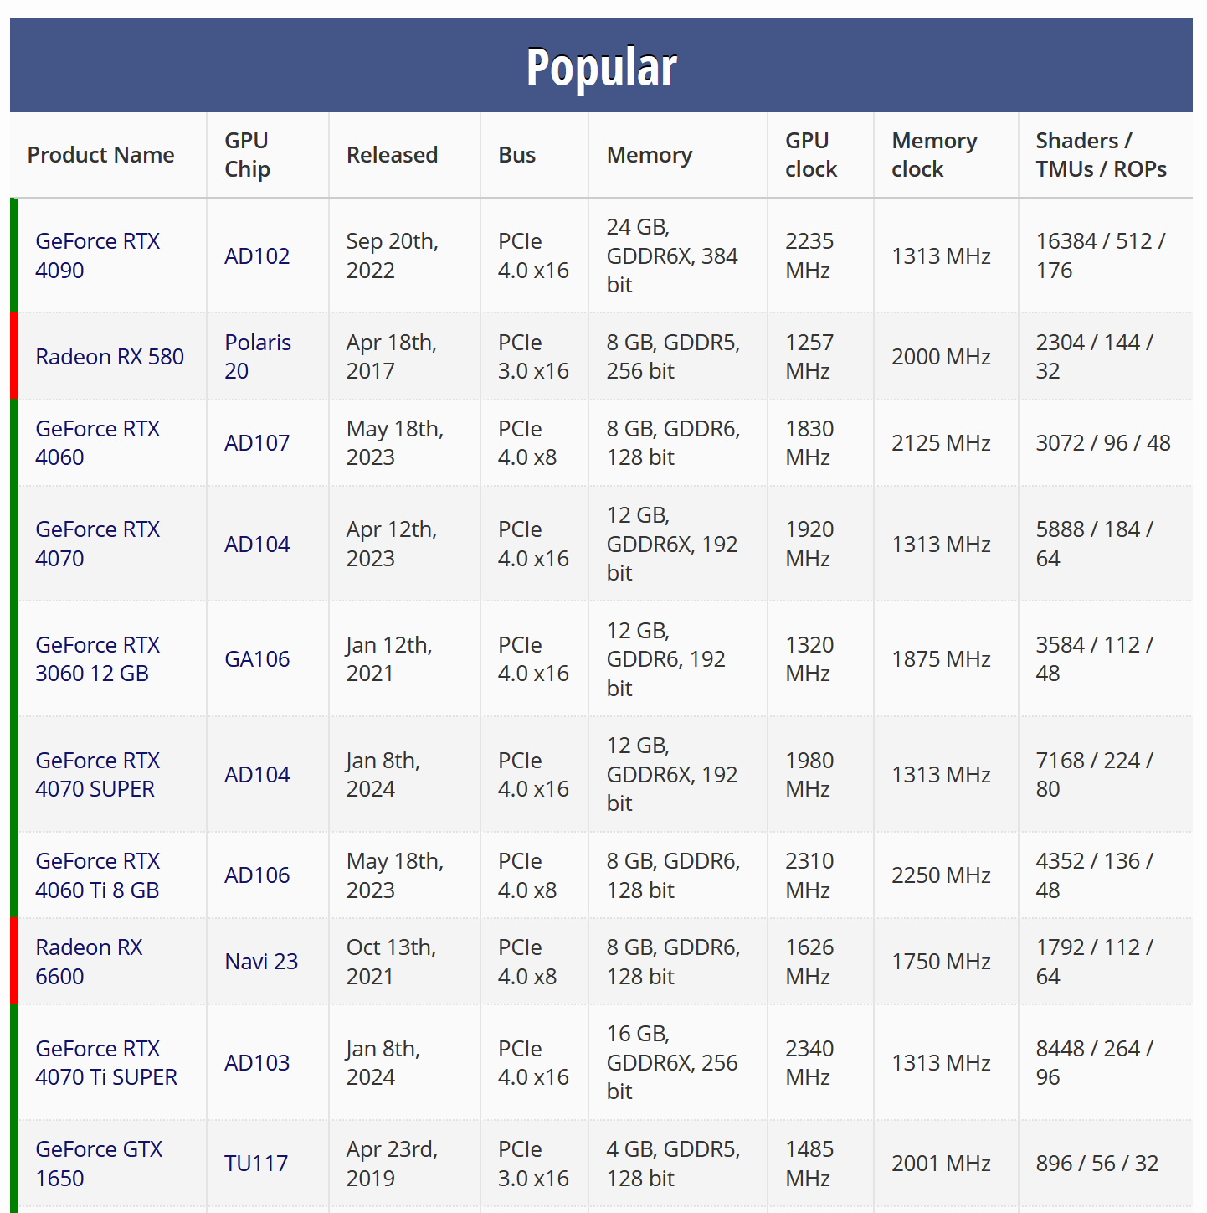
Identifying Good Substitutes is Hard…
Some products have easily-quantifiable characteristics
Computer parts
Energy sources
Grocery staples
Even when attributes are difficult-to-quantify, we “know” when products are similar
No one thinks Frozen II is a close substitute for A Bad Moms Christmas

Slide 4
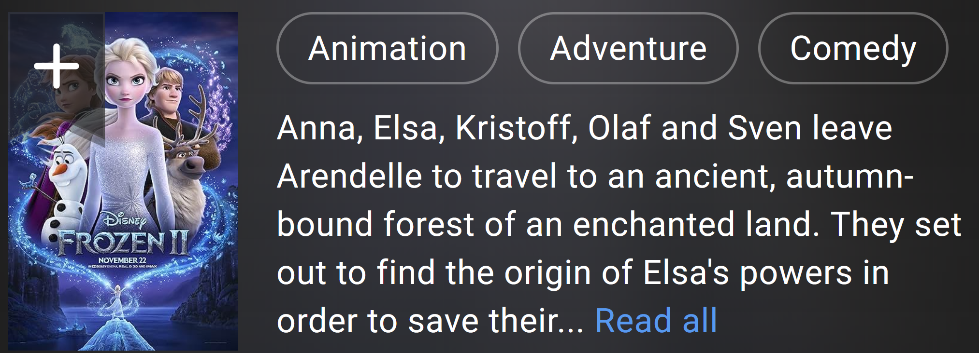
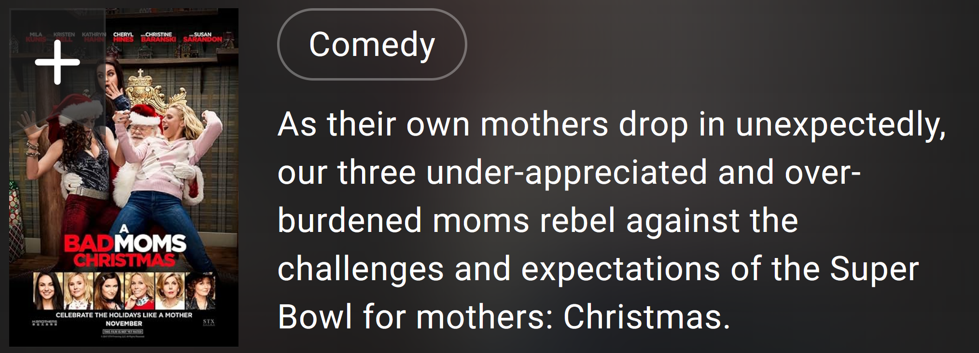
…But Firms Try to Make It Easy
Firms produce descriptions to convey their products to consumers
Designed to aid customer decision-making
Using these descriptions, can capture underlying characteristics

Slide 5

The Goal
Use OpenAI text embeddings
API takes in a string of text and provides a vector measuring the content
Projects text into underlying “characteristic space”
Following Magnolfi et al., can use these embeddings to estimate substitution patterns
Identify substitution based on entry and exit of movies from cinemas

Slide 6
Existing Literature
Methodology is most similar to Magnolfi et al. 2022
Uses triplet embeddings to estimate substitution in ready-to-eat breakfast cereal
Also related to Ederer and Pellegrino 2023
They impose substitutability, rather than discovering it. All relationships are linear
Use word counts rather than embeddings: requires much more text, may miss similar goods using different words
Iterates on Compiani, Morozov, and Seiler 2023
Primarily uses image data to estimate substitution in tech purchases on Amazon
Uses some low-tech text methods, with mixed success
Contribution:
Novel setting where text characteristics are important with few substitutes
Unique market characteristics make tools uniquely effective
Uniform Pricing
Immutable Product Characteristics

Slide 7
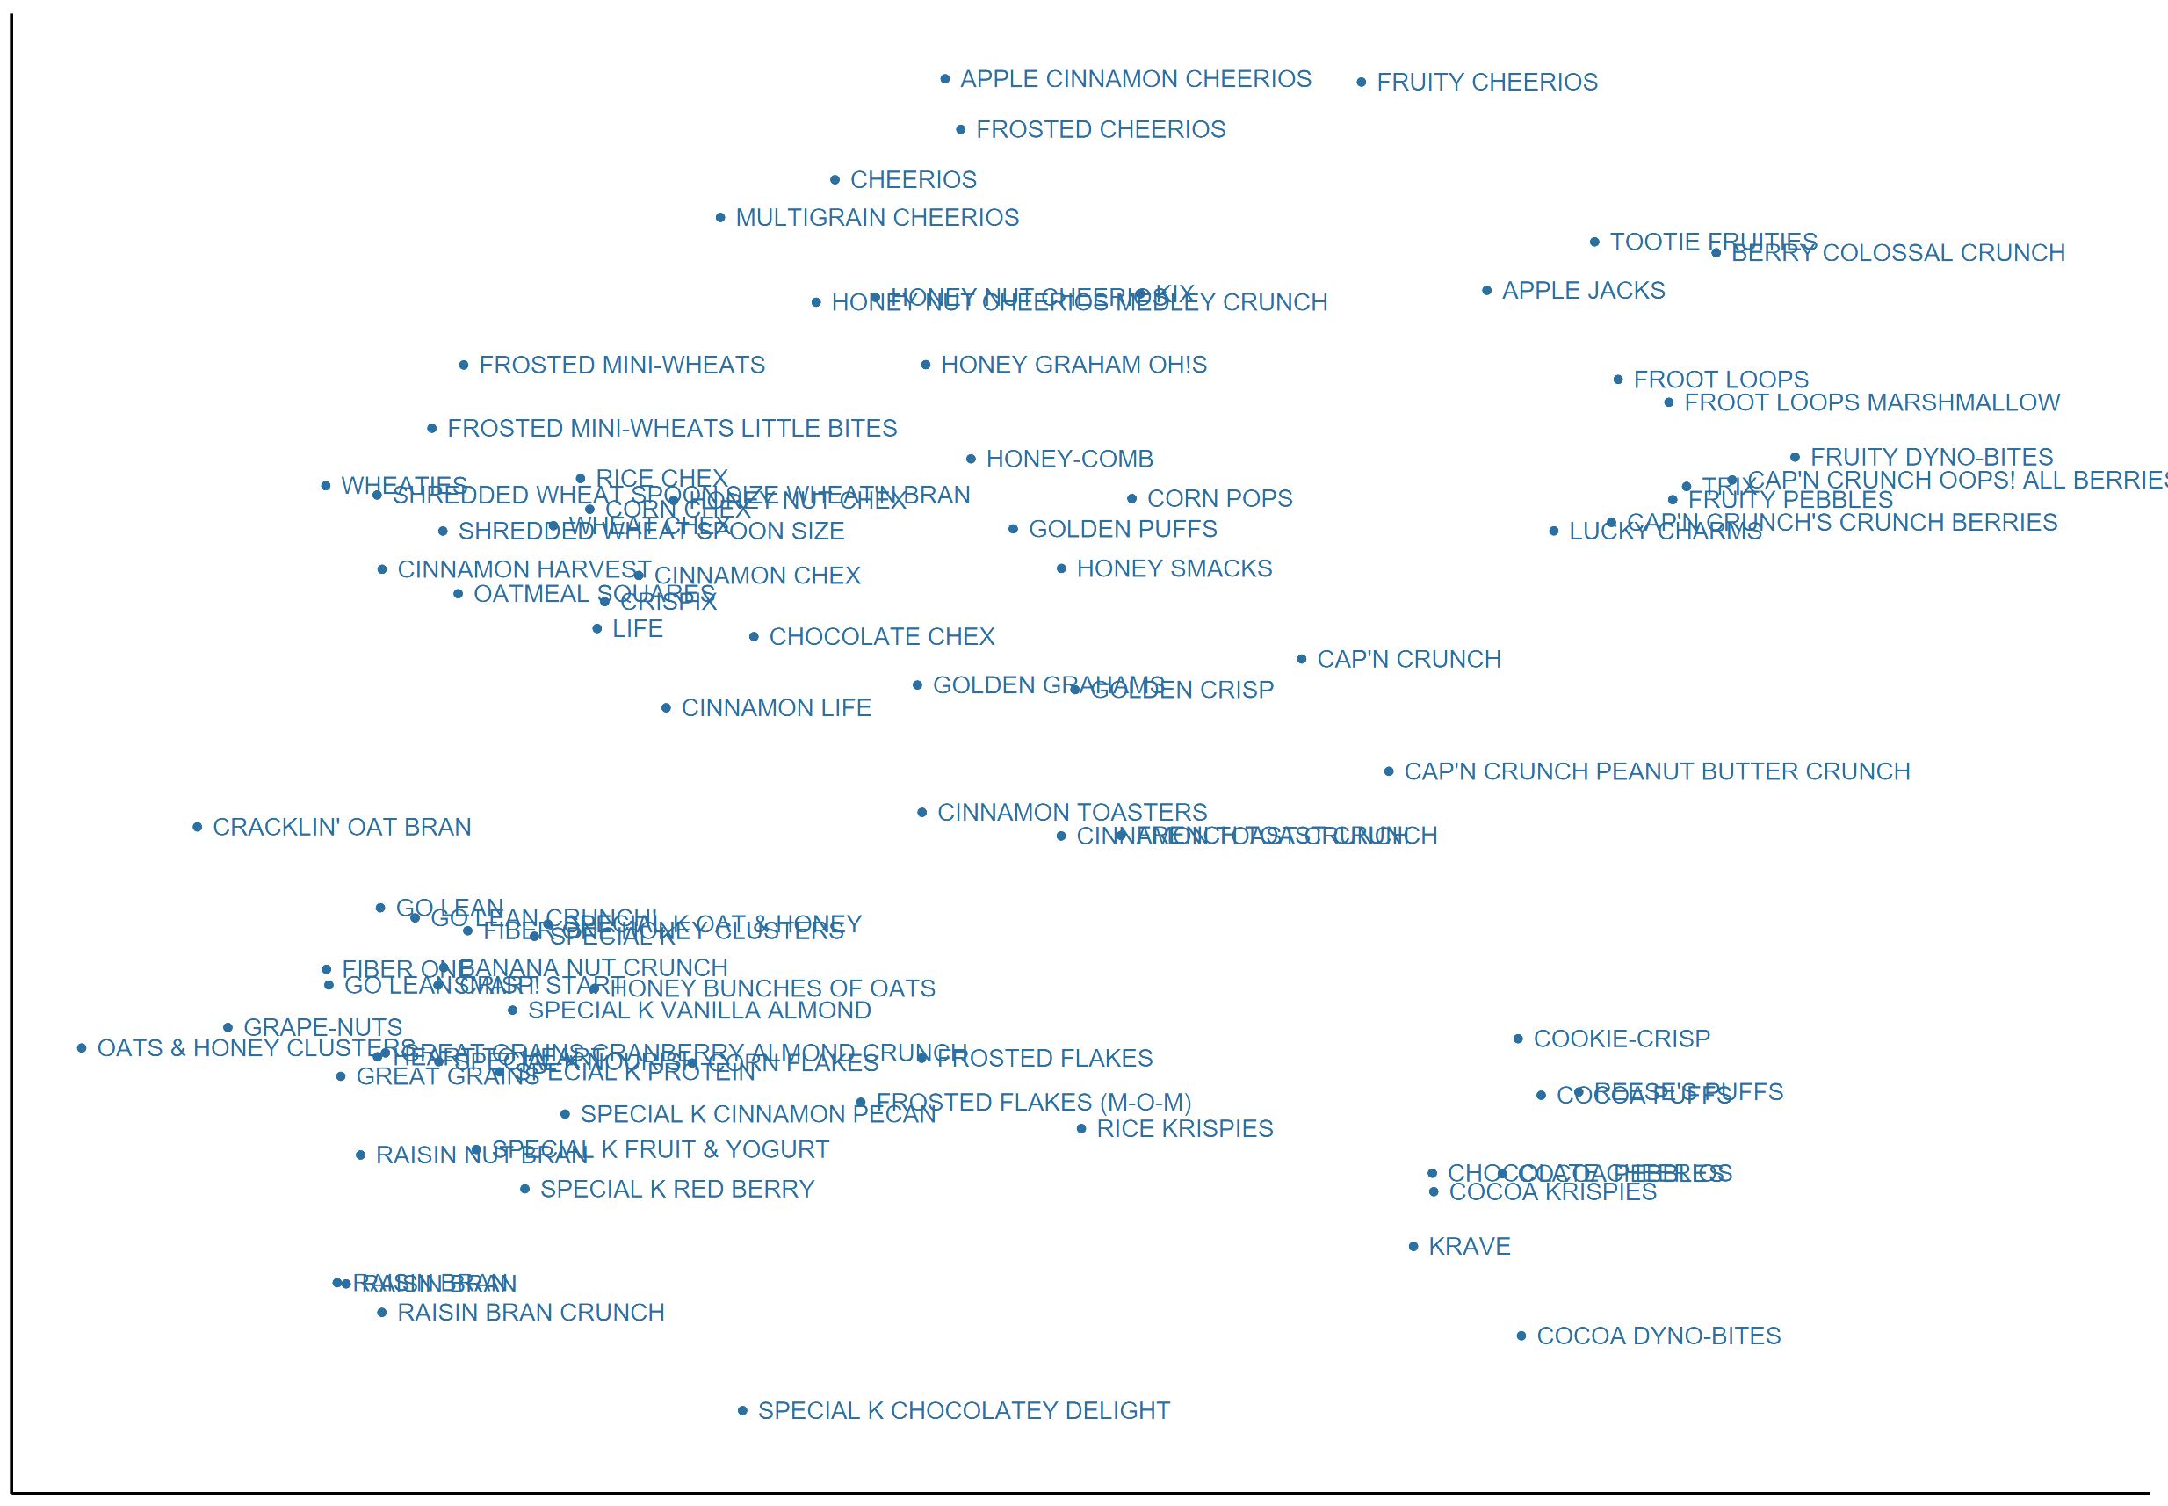
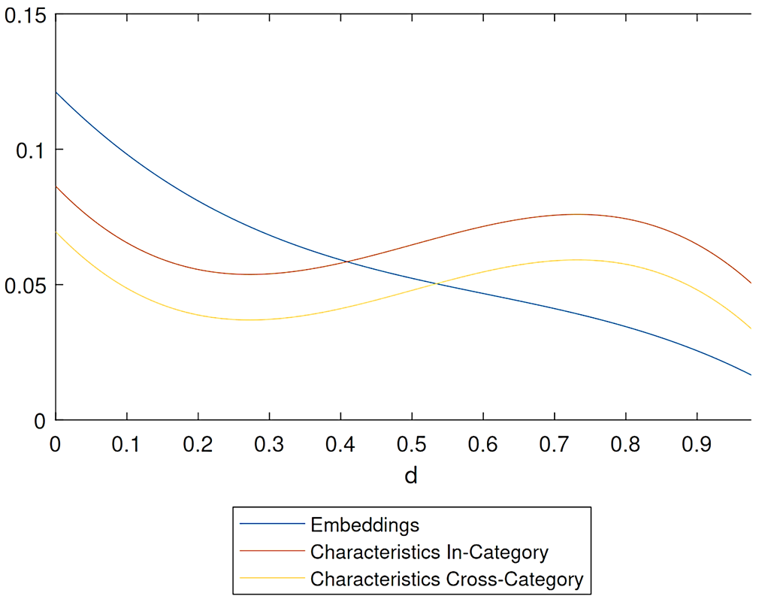
Refresher: Magnolfi
Shredded Wheat
Fruity
Chocolate
Magnolfi used triplet embeddings to cluster cereal brands
From there, showed that predicting substitution with these characteristics was better than using interpretable characteristics
Use their framework to keep hands above the table: same dimensionality, same distance metric, same distance function, same benchmarks

Slide 8
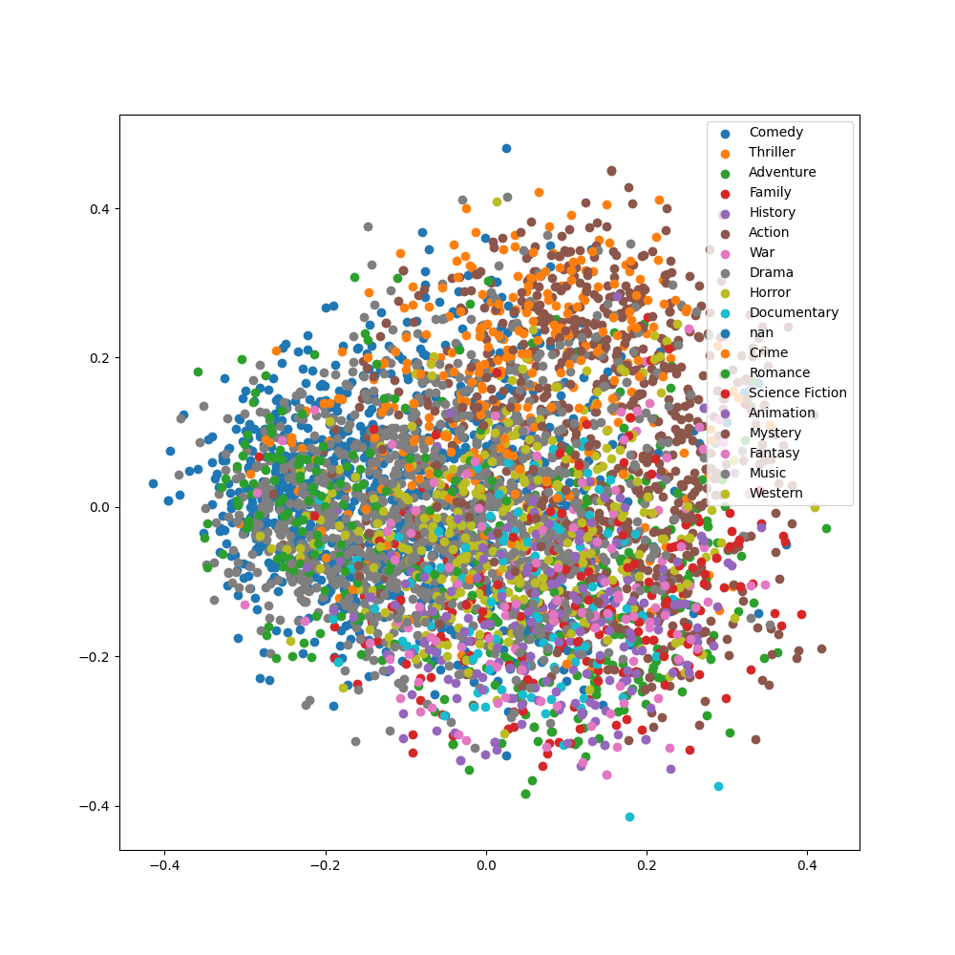
Results Preview
Thriller/Action
Characteristics of movies seem compelling given genre clustering
Elasticity estimates have reasonable:
Sign
Magnitude
Derivative
Minimal(-ish) structural assumptions
Romantic Comedy
Sci-Fi/Fantasy

Slide 9
Model & Application

Slide 10
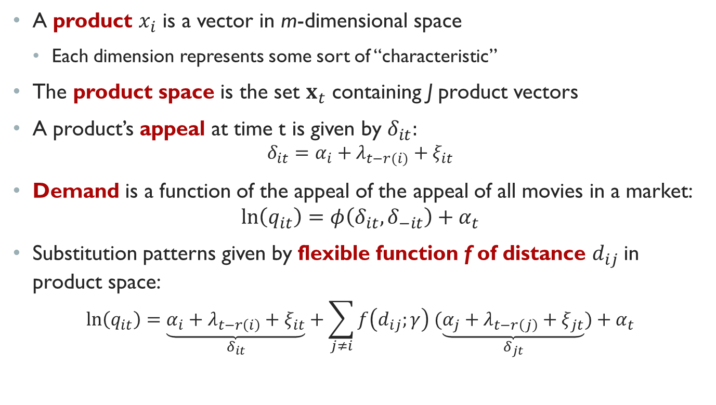
The Model
A product $x_{i}$ is a vector in m-dimensional space
Each dimension represents some sort of “characteristic”
The product space is the set $x_{t}$ containing J product vectors
A product’s appeal at time t is given by $δ_{it}:$
$$δ_{it}=α_{i}+λ_{t−r(i)}+ξ_{it}$$
Demand is a function of the appeal of the appeal of all movies in a market:
$$ln\left(q_{it}\right)=φ\left(δ_{it}, δ_{−it}\right)+α_{t}$$
Substitution patterns given by flexible function f of distance $d_{ij}$in product space:
$$\ln\left(q_{it}\right)=\underset{δ_{it}}{\underbrace{α_{i}+λ_{t−r\left(i\right)}+ξ_{it}}}+\sum_{j≠i}{f\left(d_{ij};γ\right) (\underset{δ_{jt}}{\underbrace{α_{j}+λ_{t−r\left(j\right)}+ξ_{jt}}})}+α_{t}$$

Slide 11
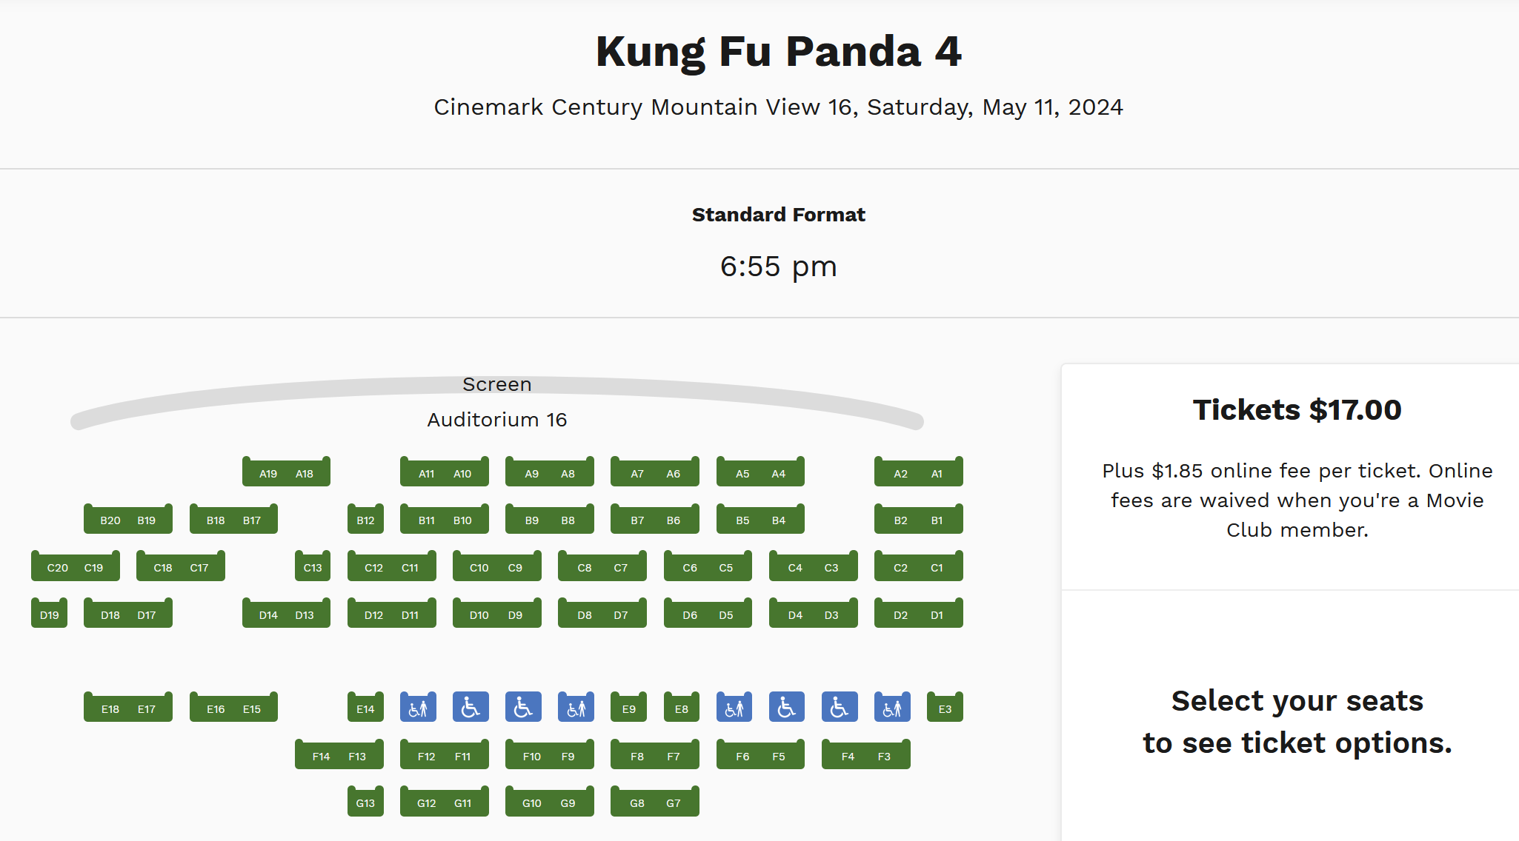
Why Movies: Uniform Pricing Puzzle
Movies have uniform pricing
Can rule out pricing response
Well-documented (though maybe starting to change?)
Orbach and Einav (2007)
Chung (2015)
Ho (2018)
Charging $17 despite having not sold a single seat!
(Movie released 3/8/24, retrieved on 5/11/24)

Slide 12


Why Movies: Exogeneous Characteristics
Within a weekend, characteristics across movies must be independent of each other
Otherwise, elasticity confounded with strategic response
Cannot move my movie in time or characteristic space
Twin Films suggest adjustment frictions:
A Bug’s Life / Antz
No Strings Attached / Friends with Benefits
Florence Foster Jenkins / Marguerite

Slide 13

Twin Movie Performance
Studios want to avoid twin films
But, for Giannoli, [Florence Foster Jenkins] was particularly galling, given he’d spent a decade on Marguerite. “I work a lot as a writer to find completely original stories. I don’t want the audience to have the feeling, ‘oh, I saw that!’”
—The Independent, 3/4/2016
Their continued existence suggests characteristics and release windows are inelastic to competition

Slide 14
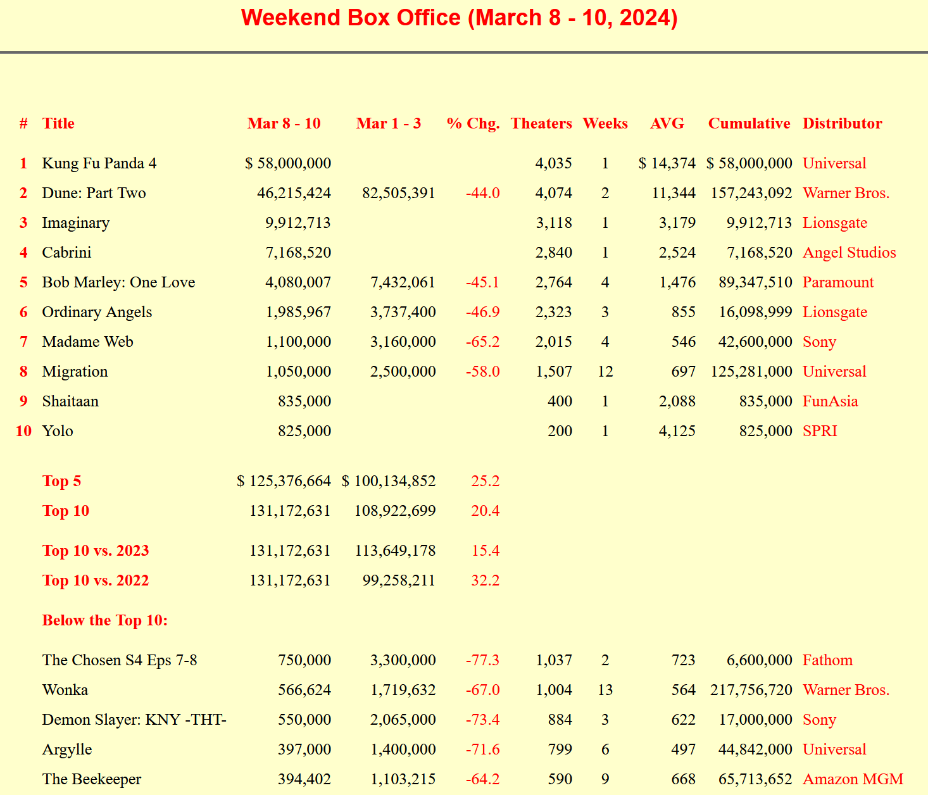
Data
Box office receipts scraped weekly from BoxOfficeGuru
1998-Present
Missing weeks when administrator was on vacation
Descriptions pulled from TheMovieDB
Free IMDB Competitor
Using Search API: search for “cleaned” title in year observed in box office data
Embeddings performed using OpenAI text-embedding-3-small engine from April
~1,500 dimensional, but reduced to six with PCA

Slide 15
Clustering Results

Slide 16
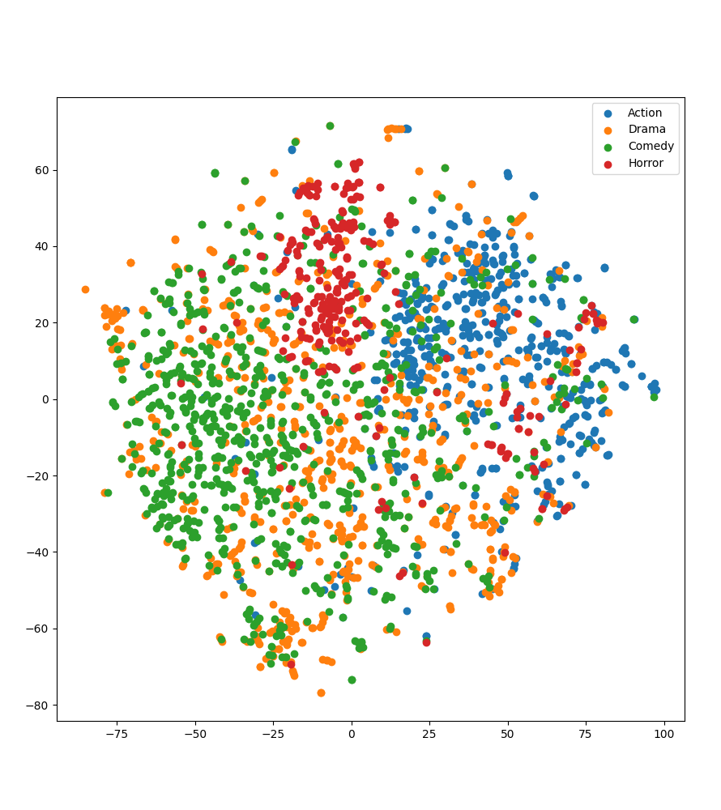
Genre Clustering
1,500-dimensional vectors from OpenAI
Reduce dimensionality using PCA
Clusters movies of same genre without training

Slide 17
Log-Linear Demand Model

Slide 18
Log-Linear Demand Model
$$\ln\left(q_{jt}\right)=α_{j}+α_{t}+β_{j}\ln\left(p_{jt}\right)+\sum_{k≠j}{f\left(d_{jk};γ\right)\ln\left(p_{kt}\right)+λ_{t −r(j)}+ε_{jt}}$$
Lifted near-wholesale from Magnolfi, except:
Prices are constant given uniform pricing—all absorbed into intercept
Movies thrive on novelty, so add movie-age fixed effects (r(j) is release week of movie)
Uniform pricing allows proxying for quantity with total box-office revenue
Function f interpretable as cross-elasticity
Identified within movie via market entry and exit
Identified between movie via exogeneous placement

Slide 19
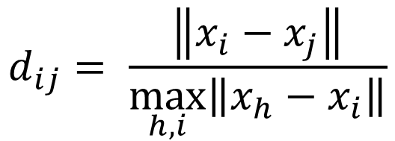
Functional Form
Following Magnolfi, McClure, and Sorensen (2024), use a cubic polynomial:
Normalized using largest observed difference
$$f\left(d_{ij};γ\right)=γ_{0}+γ_{1}d_{ij}+γ_{2}d_{ij}^{2}+γ_{3}d_{ij}^{3}$$
$$d_{ij}= \frac{\left\|x_{i}−x_{j}\right\|}{\max_{h, i}\left\|x_{h}−x_{i}\right\|}$$

Slide 20
Nearest Neighbors Sanity Checks Euclidean Distance
Movie | Nearest Neighbor #1 | Nearest Neighbor #2
Frozen | Little Mermaid | Princess Diaries 2
Dune: Part 1 | Dune: Part 2 | Black Panther II
The Notebook | Collateral Beauty | I Still Believe
Avengers: Endgame | X-MEN: Days of Future Past | Guardians of the Galaxy 3
A Bug’s Life | The Spongebob Movie | DC League of Super Pets

Slide 21
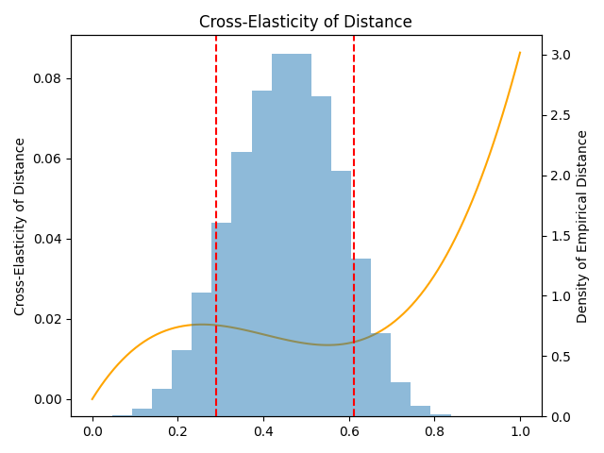
Cross-Elasticities Over Euclidean Distance
Histogram in background plots support of the data
Thus, we see substitution generally falls monotonically(ish) with distance

Slide 22



Interpretation
Disney is launching Frozen this weekend
During the same weekend, Pokémon: The Movie 2000 is showing
10th percentile distance from Frozen
Suppose instead we replaced Pokémon with Sandra Bullock’s Premonition
90th percentile distance from Frozen
Model suggests 0.0044 log-point bump in quantity for Frozen
i.e., around 0.44% revenue increase
Seems reasonable?

Slide 23
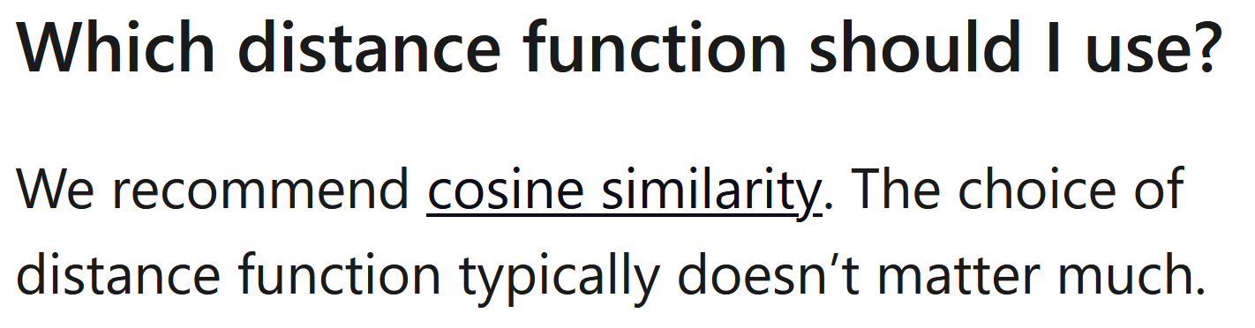
Beyond Magnolfi: Cosine Distance
Thus far, I have stuck as closely as possible to Magnolfi
Fits project into existing literature
Validates “hands above the table” claims
However, one obvious improvement would be to use cosine distance rather than Euclidean
Uses the full embeddings, uncompressed
Suggested by OpenAI
More standard in the text analysis literature
From the OpenAI FAQ

Slide 24
Nearest Neighbors Sanity Checks Cosine Distance
Movie | Nearest Neighbor #1 | Nearest Neighbor #2
Frozen | Frozen II | Mirror Mirror
Dune: Part 1 | Dune: Part 2 | Voyagers
The Notebook | Message in a Bottle | The Longest Ride
Avengers: Endgame | Avengers: Infinity War | Captain America: Civil War
A Bug’s Life | The Ant Bully | Antz

Slide 25
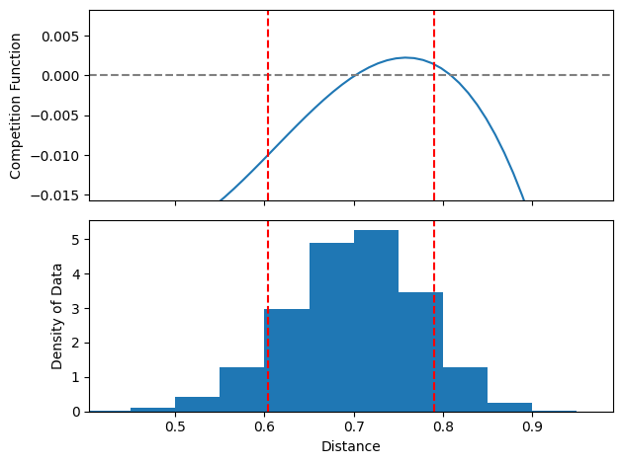

Slide 26



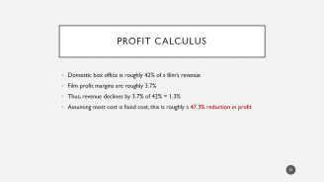
Interpretation
Disney is launching Frozen this weekend
During the same weekend, Medieval is showing
90th percentile distance from Frozen
Suppose instead we replaced Medieval with Inkheart
10th percentile distance from Frozen
Model suggests 0.033 log-point decline in revenue
47.3% reduction in profit assuming mostly fixed costs

Slide 27
Conclusion

Slide 28

Efficacy of Text Embeddings
Text embeddings produce reasonable (negative, monotone, attenuating, zero-when-distant) substitution patterns while mimicking real decision-maker information
Captures characteristics firm believes are most important
Astoundingly cheap: this whole project cost <$0.03

Slide 29

Next Step: Benchmarking
Thus far, validating based on what “looks right”
Benchmark with real taste patterns
MovieLens released 25m movie ratings from real users
Would need recommendation engine (e.g. Topic-Specific PageRank)
What would you want to see here?
Correlation between similarity measures?
Re-estimating model using these values?

Slide 30
Next Step: Age and Distance
$$\ln\left(q_{jt}\right)=α_{j}+α_{t}+β_{j}\ln\left(p_{jt}\right)+\sum_{k≠j}{f\left(d_{jk};γ\right)\ln\left(p_{kt}\right)+λ_{t −r(j)}+ε_{jt}}$$
Following Magnolfi, I have so far used distance independently from age
But we think newer movies are more important
i.e., releasing the same week as a similar movie should be “worse” than entering two months after
Thus, distance should interact (somehow) with age
What functional form is both parsimonious and convincing?

Slide 31
Next Step: Exogeneous Timing Check
To believe these substitution estimates, need to believe within-week characteristics are independent of competitors’ characteristics
Currently defending this using field knowledge of twin movies
“If studios could change, we wouldn’t see these movies fighting so directly”
Can extend this logic to a testable hypothesis
Distribution within week should match overall distribution (modulo time trends)
That is, there should be no missing mass “close to” movies
Is this convincing? What else would we expect to see given endogeneity?

Slide 32
Appendix

Slide 33
Profit Calculus
Domestic box office is roughly 42% of a film’s revenue
Film profit margins are roughly 3.7%
Thus, revenue declines by 3.7% of 42% = 1.3%
Assuming most cost is fixed cost, this is roughly a 47.3% reduction in profit

Slide 34
Genre
$$\ln\left(q_{jt}\right)=α_{j}+α_{t}+β_{j}\ln\left(p_{jt}\right)+\sum_{k≠j}{f\left(d_{jk};γ\right)\ln\left(p_{kt}\right)+{\vec{γ}}^{′}\vec{age_{jt}}+genre_clash_{jt}+ ε_{jt}}$$
Want to see how much of distance is captured by genre
Include dummy for whether another movie of the same genre is competing
TMDB assigns multiple genres per movie, I assign the first one

Slide 35
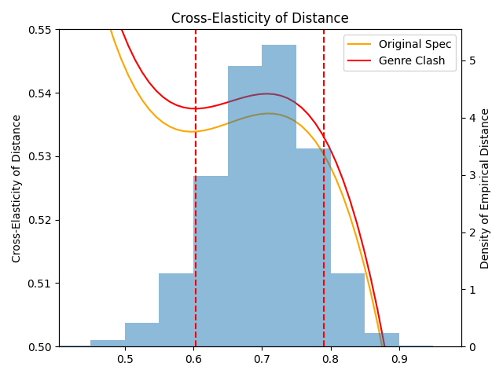
Genre Cross-Elasticities
Genre dummy soaks up little of the variation
If anything, increases the signal we’re picking up

